Slide 1
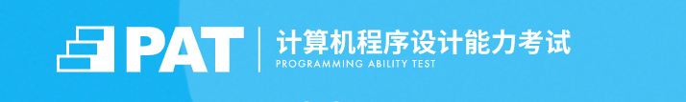
About PAT

Slide 2
The Programming Ability Test Candidates
Demand Analysis
1. User Analysis
Users Who Want to Improve Programming Ability
Enterprise

Slide 3
User Related News Test Registration Supporting Courses Information About the Test Check the Verification Exercise Shop
Demand Analysis
2. Functions

Slide 4

Demand Analysis
3. Page Design

Slide 5
Interaction
Instructional interaction
teacher-student interaction
student-student interaction
Interface interaction
Resource interaction
Interaction
The instructional interaction of E-learning platform is defined as the method and process of information exchange among teaching elements supported by the network teaching environment, which mainly includes teacher-student interaction, student-student interaction and teacher-student and learning materials.

Slide 6
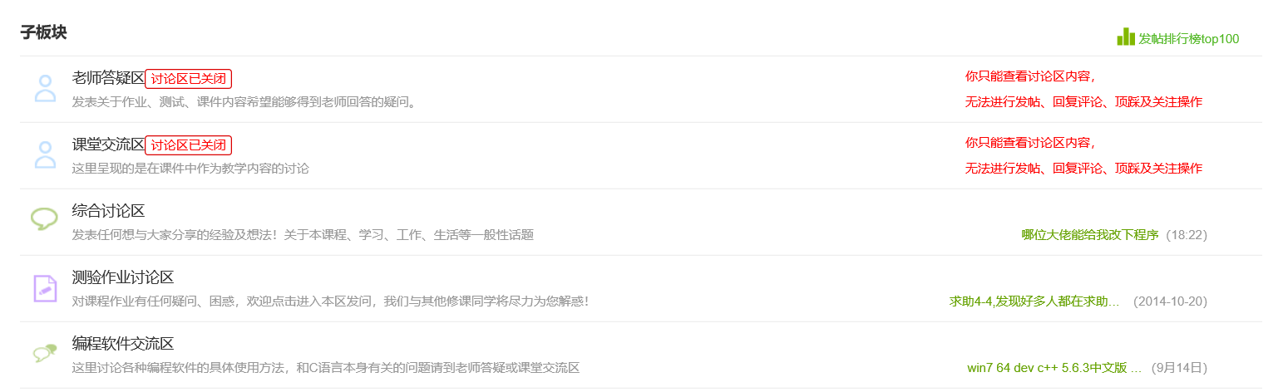
The instructional interaction of the PAT website we chose is mainly reflected in the discussion section…
The discussion section is divided into five sub-sections:
1.teacher answer section
2. classroom communication section
3. comprehensive discussion section
4. test assignment discussion section
5. programming software communication section

Slide 7
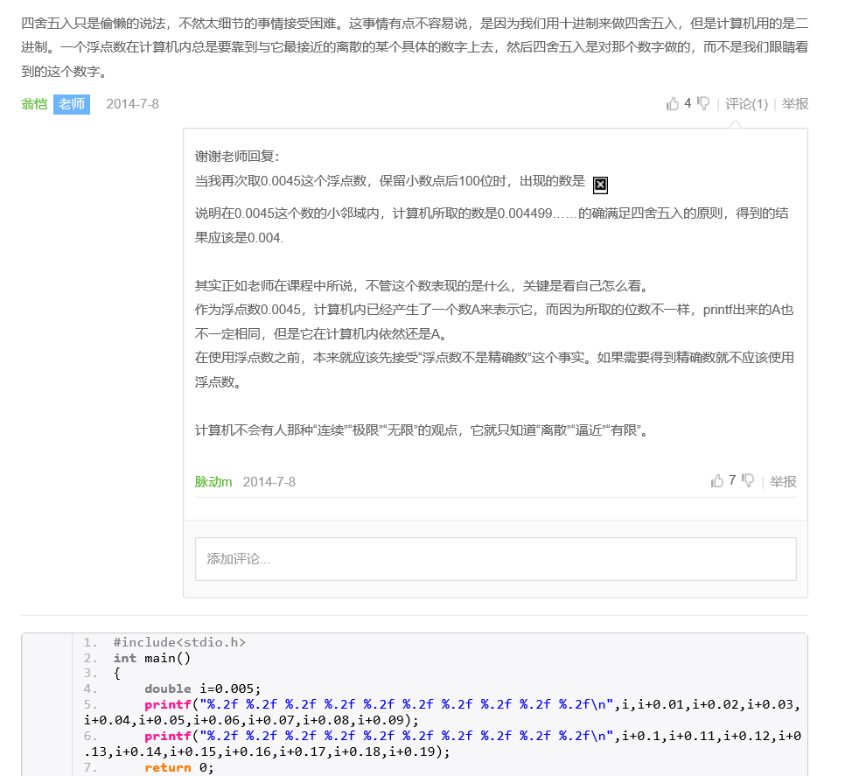
teacher-student interaction
1.teacher answer section

Slide 8
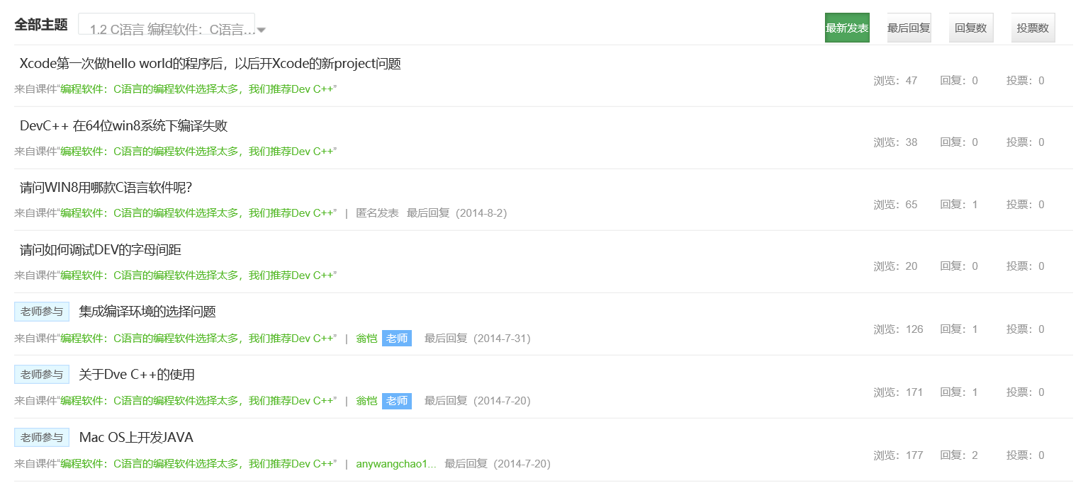
teacher-student interaction
2. classroom communication section
Teachers can give feedback and suggestions on students' questions at any time, so as to promote further learning.

Slide 9
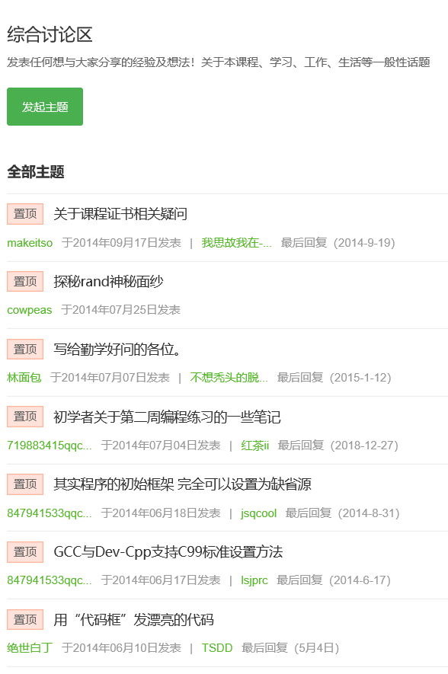
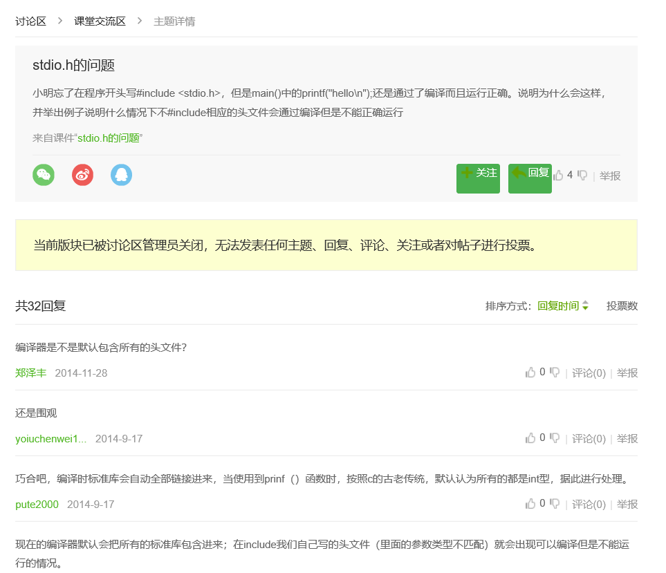
student-student interaction
2. classroom communication section
3. comprehensive discussion section

Slide 10
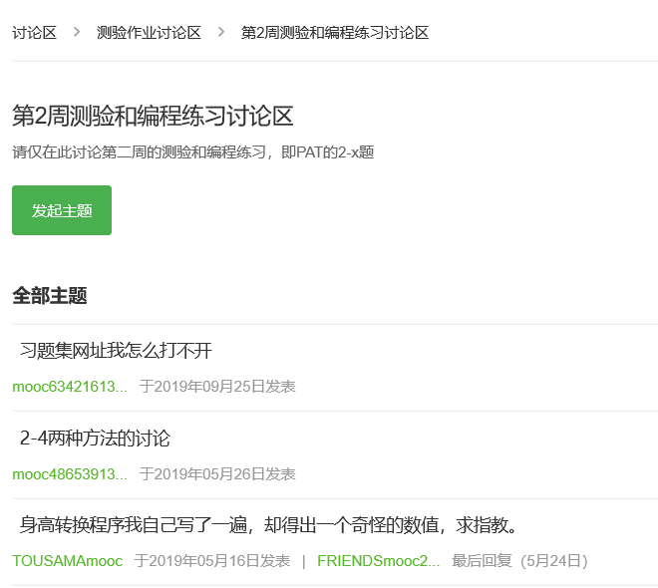
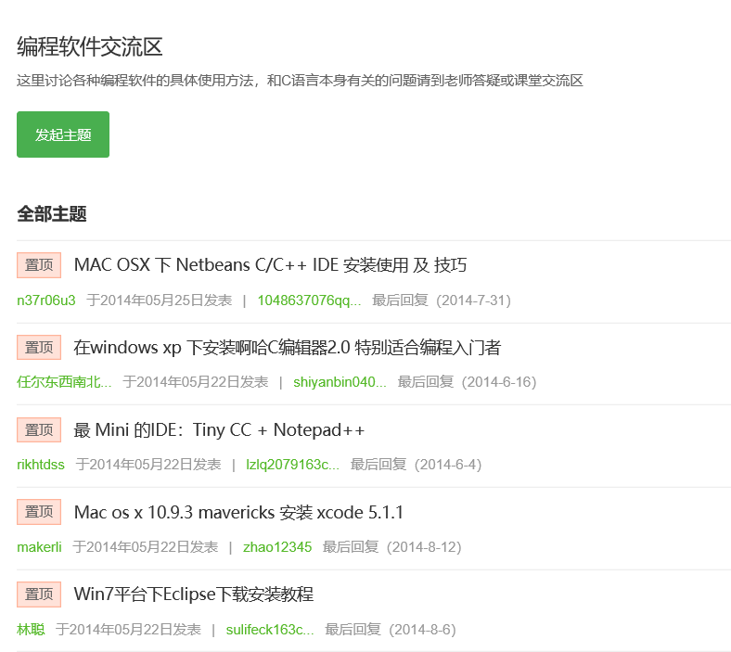
student-student interaction
4. test assignment discussion section
5. programming software communication section
Each district has its own discussion topic to meet learners' personalized learning needs and enrich their learning experience, so as to master the knowledge more comprehensively and deeply.

Slide 11
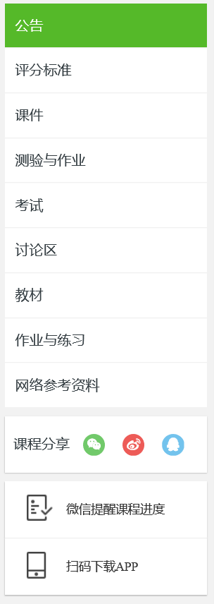
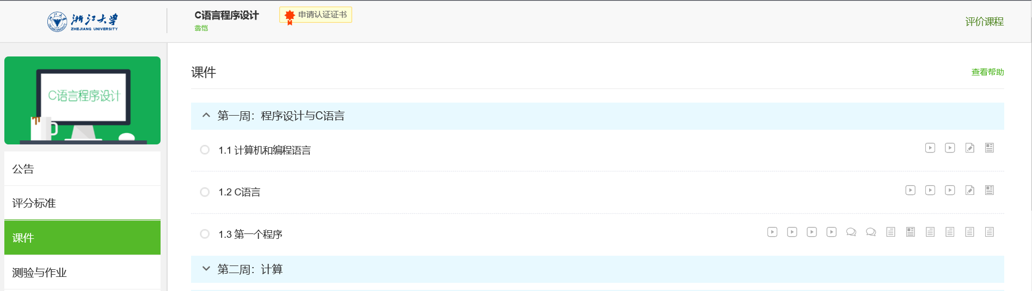
resource interaction
The resources provided by the supporting courses include video, lecture notes, literature, etc., which are available for students to download and save and facilitate students to expand their knowledge.

Slide 12
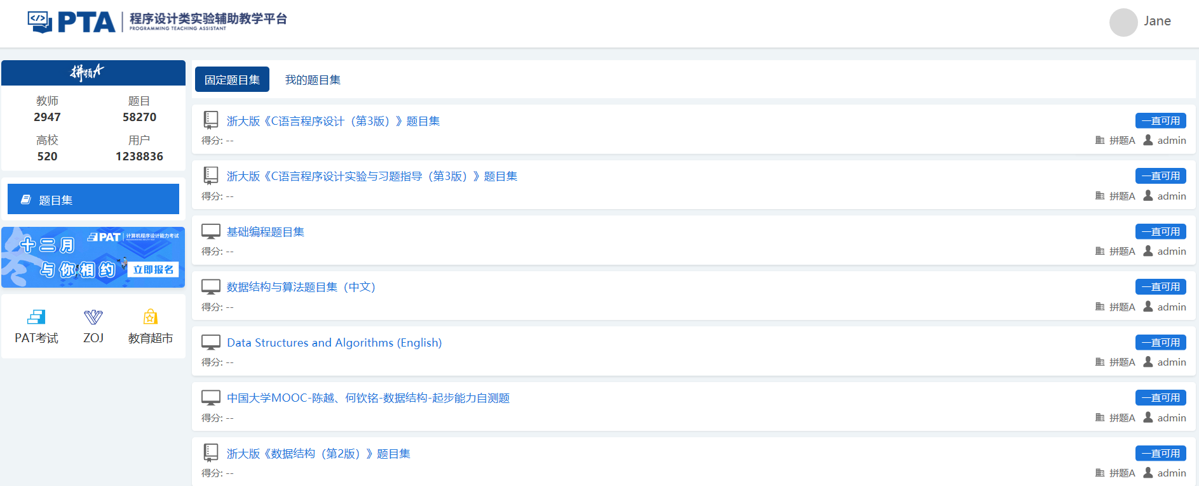
resource interaction

Slide 13
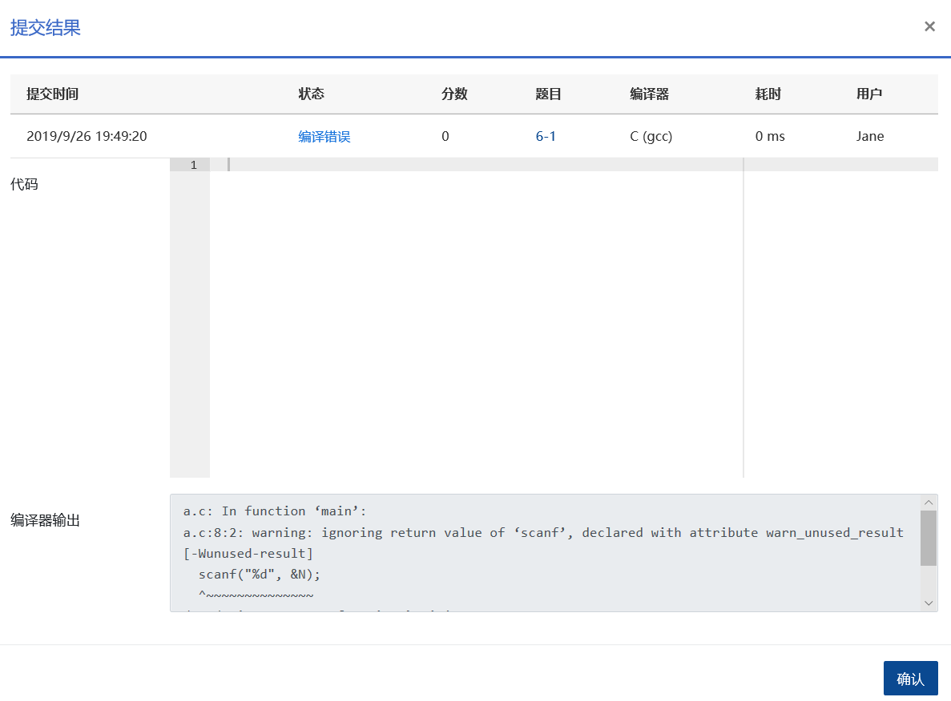
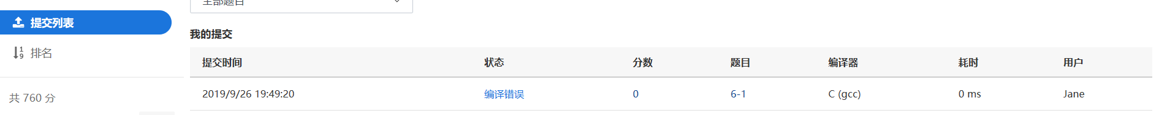
resource interaction
After entering the exercise module and submitting it, time consumption, scores and correct answers will be displayed.If you enter the submission list on the left, you can see the title submitted by the user, and click the serial number of the title to directly open the specific title.

Slide 14
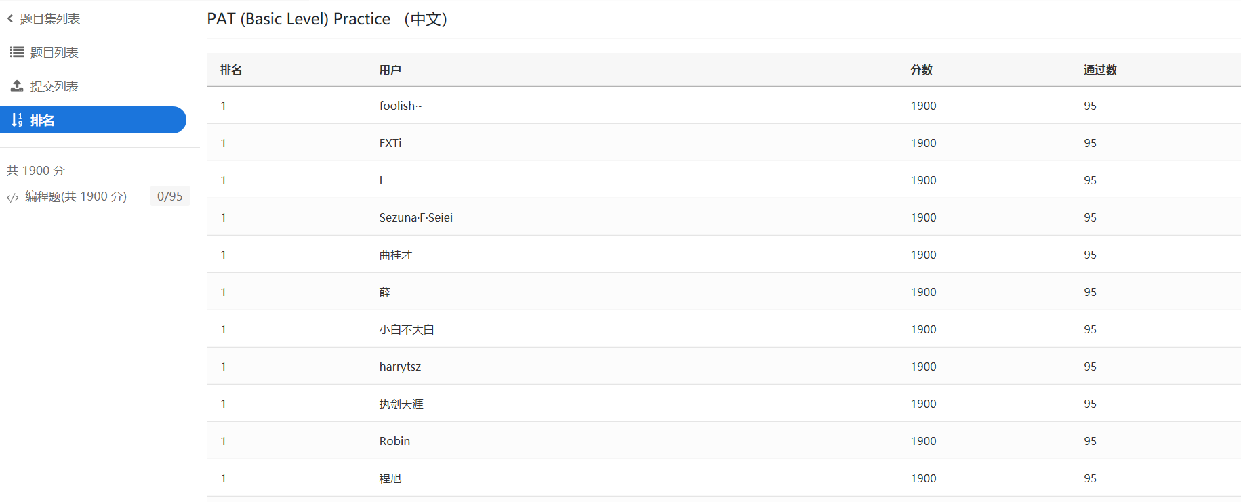
resource interaction
The exercises can help students to independently choose the question bank of the exercises, and have immediate feedback, as well as their own ranking in all users, which is conducive to positioning their learning level and enhancing their learning motivation.

Slide 15


instructional interaction
discussion board
exercise module
other……

Slide 16


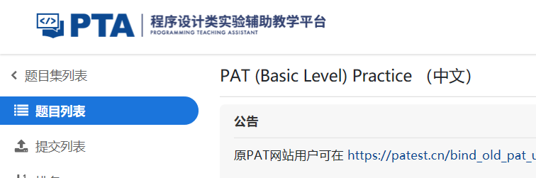
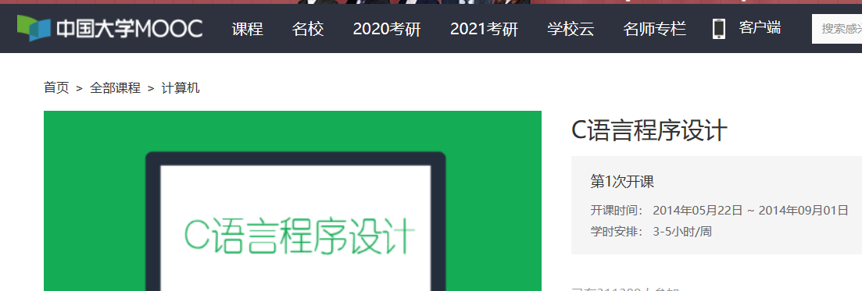
interface interaction
user experience
easy to operate
easy for users to grasp
Most operation pages can be returned to the main page by clicking the PAT logo in the upper left corner.
As the accompanying courses and exercises are directly linked to external websites, to return to the interface of PAT platform, one can only click back or re-enter, which needs to be improved.

Slide 17
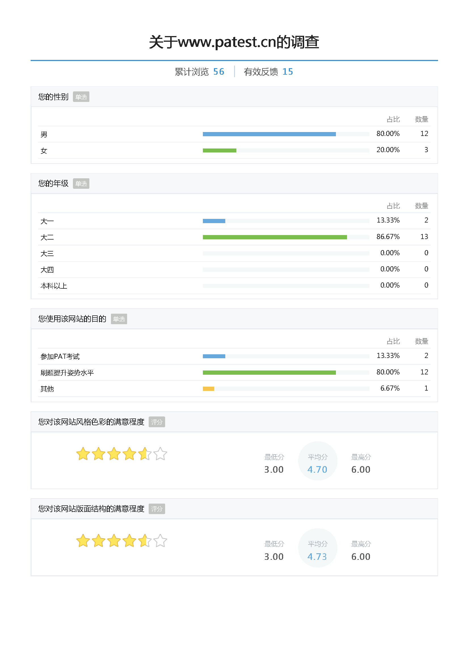
User experience survey

Slide 18
User experience survey

Slide 19
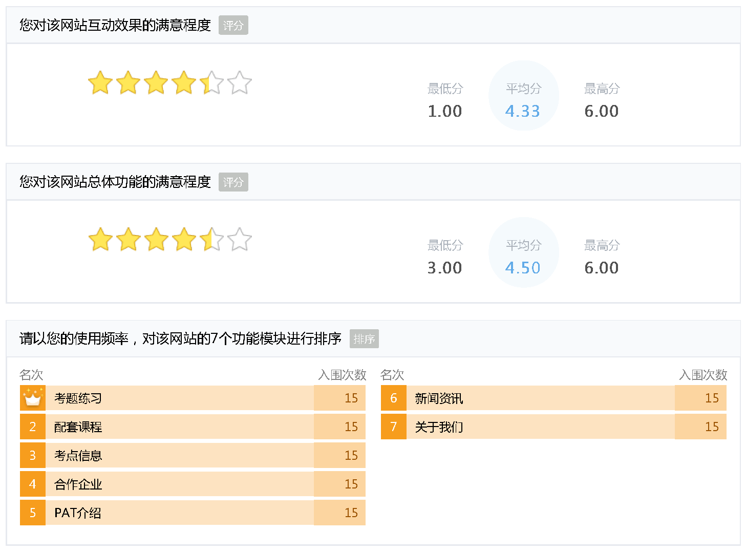
User experience survey

Slide 20
使用该网站过程中， 您认为该网站有什么优点 | 使用该网站过程中， 你是否有发现bug或令你感到不爽的地方 | 您对该网站有什么改进建议
无 | 否 | 无
题目类型多，数量多 | 测试点没有过的话，虽然不能直接给出测试样例，但也应该给一些提示（hint) | 增加一些有用功能，目前网站除了考题练习之外好像有价值得功能并不多。
无 | 无 | 无
无 | 有 | 无
无 | 报错不友好，友好模式参考leetcode | 无
挺好的 | 自动刷新之后返回题目不是很方便 | 无
题目众多 | 否 | 无
wu | 同PTA | 無
好用 | bug | 修bug
好用 | bug | 修bug
无 | 否 | 无
题 | 无 | 无
无 | 无 | 无
无 | 网页偶尔载入缓慢 | 改善载入缓慢出错的问题
可以在线刷题，挺好的 | 目前没有 | 无

Slide 21
User experience analysis
Layout
Rich, balanced and consistent visual effect
Without redundant information
Style
Simple style and neutral color
Obvious visual center
Appropriate blank space
Function
Interactive response
PAT VS. LeetCode (www.leetcode.com)
Larger database
Timely feedback
More interesting topics
Fast and effective response
Balancing operability and complexity

Slide 22
Suggestions
As the accompanying courses and exercises are directly linked to external websites,
to return to the interface of PAT platform,
one can only click back or re-enter, which needs to be improved.
An online assistant can be set to answer questions online at any time to answer any questions encountered by users in the process of using the platform, so as to enhance the intelligence and sense of belonging of the platform.
Prompts and instructions should be given if the code runs into an error.

